Slide 1
Weather application NAME:-ADITI PANDEY BATCH :-3

Slide 2
agenda
INTRODUCTION 3
Problem and their Solution 4

Slide 3
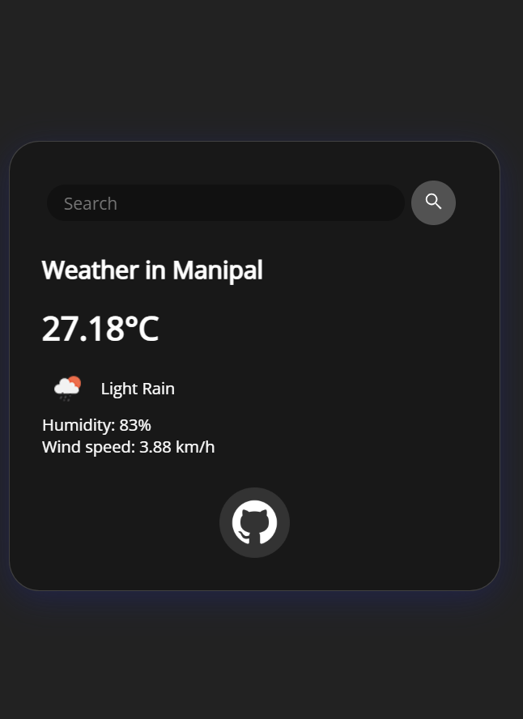
Get current weather by city name or geographic coordinates. Display temperature, humidity, weather description, and wind speed. Error handling for invalid city names or network issues.
Error handling for invalid city names or network issues.

Slide 4
Node.js – Server-side JavaScript runtime Express.js – Web framework for Node.js Axios or Node-fetch – For making HTTP requests EJS / Handlebars / HTML+CSS – For front-end rendering (optional) OpenWeatherMap API – Popular weather data provider (free tier available)

Slide 5
1.Inaccurate Forecasts Problem: Users often complain about inaccurate or outdated weather predictions. Causes: Poor data sources Infrequent updates Lack of local weather stations Solutions: Integrate with multiple reliable weather APIs (e.g., OpenWeather, AccuWeather, NOAA). 2. Slow Performance and Lag Problem: The app takes too long to load or update weather information. Causes: Large data requests Poorly optimized backend/frontend Weak device or network connection Solutions: Use caching to store previously loaded data.

Slide 6
thank you
ADITI PANDEY
aditipandey6309@gmail.com
https://github.com/Aditi65/PROJECT

